Slide 1
Expressing Yourself with C# Expression Trees
Chad Kulesa
Enterprise Architect

Slide 2

Code == Data
Dynamically modify code at run time.
Create new code at run time.
Translate code to another language (SQL, Xpath, etc.)
Strongly typed.

Slide 3

Lambda Expression Tree
Expression<Func<string, bool>> expression =
x => x == "Value";

Slide 4
API Expression Tree
var x = Expression.Parameter(typeof(string), "x");
Expression<Func<string, bool>> expression =
Expression.Lambda<Func<string, bool>>(
body: Expression.Equal(
left: x
right: Expression.Constant("Value")),
parameters: x);

Slide 5
Expression<Func<string, bool>> expression =
x => x == "Value";
var x = Expression.Parameter(typeof(string), "x");
Expression<Func<string, bool>> expression =
Expression.Lambda<Func<string, bool>>(
body: Expression.Equal(
left: x,
right: Expression.Constant("Value")),
parameters: x);

Slide 6
Benefits
Lambda
API
Easier to read
Don’t need to learn the API
Compiler will simplify constant expressions
Additional commands available
Dynamically create expression trees at run time
Compiler won’t simplify constant expressions

Slide 7

Expression Trees are Immutable

Slide 8
BinaryExpression
NodeType
C# Operator
Add
Subtract
Divide
Multiply
And
Or
AndAlso
OrElse
Equal
NotEqual
+
-
/
*
&
|
&&
||
==
!=

Slide 9
() => (4 + 5) * 3
Expression.Lambda<Func<int>>(
body: Expression.Multiply(
left: Expression.Add(
left: Expression.Constant(4),
right: Expression.Constant(5)),
right: Expression.Constant(3)));

Slide 10
() => 4 + (5 * 3)
Expression.Lambda<Func<int>>(
body: Expression.Add(
left: Expression.Constant(4),
right: Expression.Multiply(
left: Expression.Constant(5),
right: Expression.Constant(3))));

Slide 11

Code Time

Slide 12
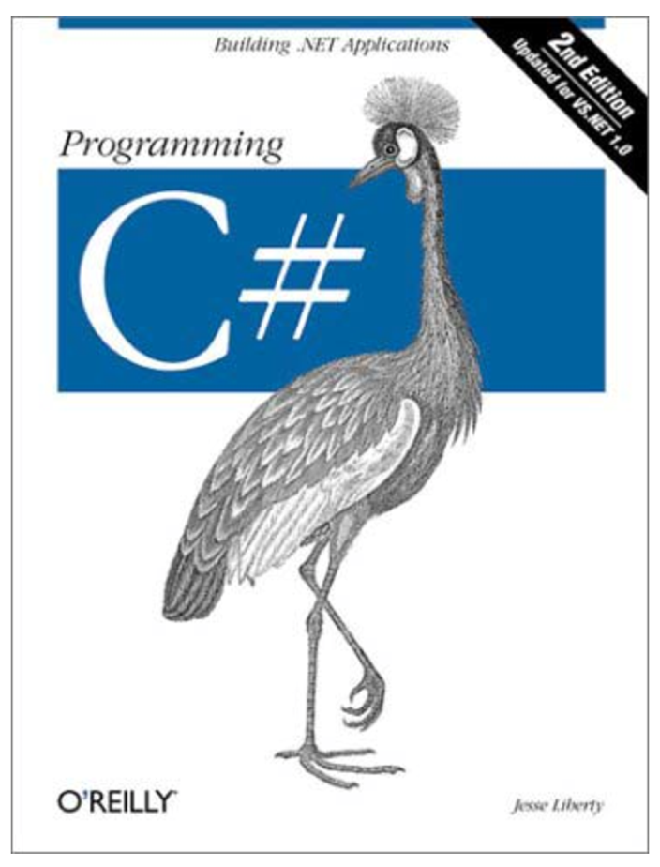
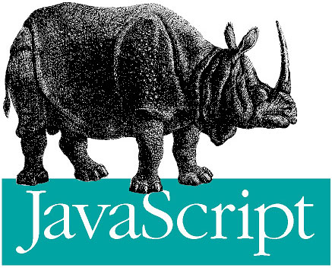

But first…
It’s time to turn C# into Javascript!

Slide 13
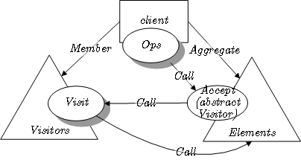

The Visitor Pattern

Slide 14


The Visitor Pattern
Expression
Invocation
Expression
Handler
Parameter
Expression
Handler
Unary
Expression
Handler
Method
Expression
Handler
Binary
Expression
Handler
Member
Expression
Handler

Slide 15


Slide 16
Where to go from here?
www.chadkulesa.com – Download the code from this presentation.
metalinq.codeplex.com/ – LINQ to Expressions. Using LINQ to modify expressions.
blogs.msdn.com/b/mattwar/archive/2008/11/18/linq-links.aspx – How to build a LINQ provider

